Slide 1


Guidelines for Viewing Estimated Shipment Time
2025.08

Slide 2
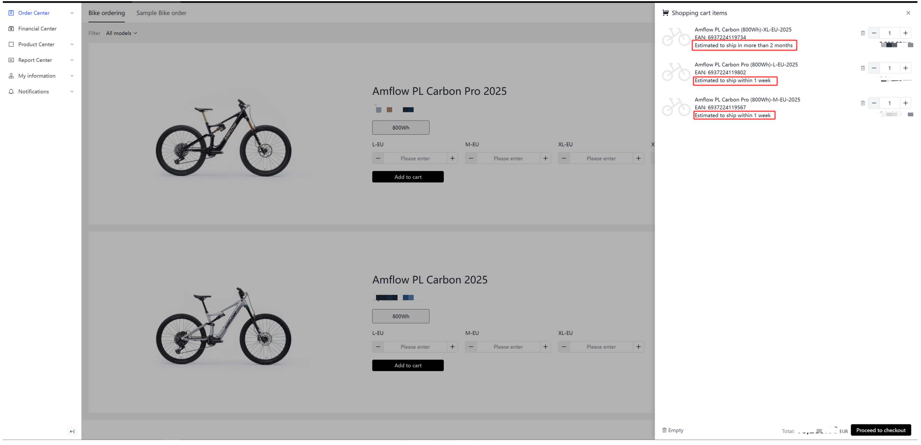
1.During product selection:
When selecting products, you can see the estimated shipment time for items in your shopping cart.

Slide 3
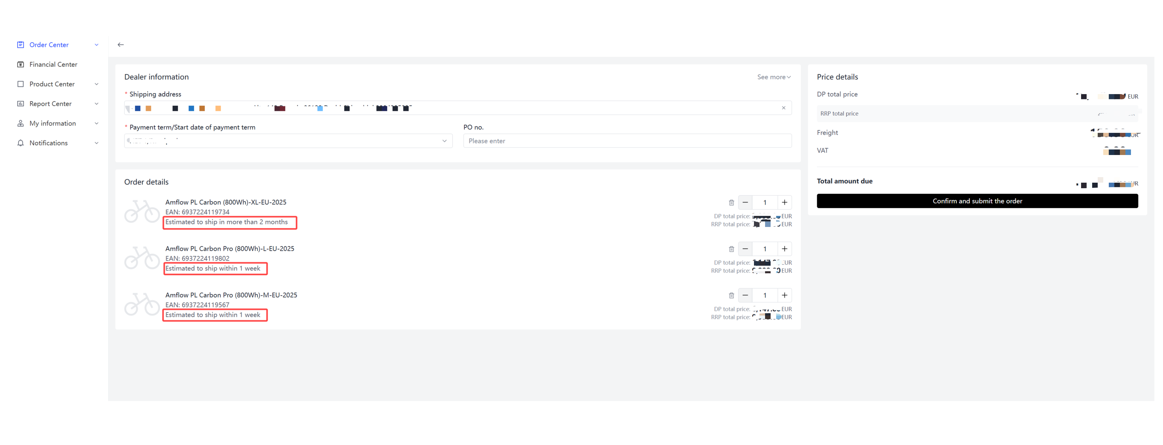
2.On the order submission page:
You can also check the estimated shipment time before finalizing your order.

Slide 4
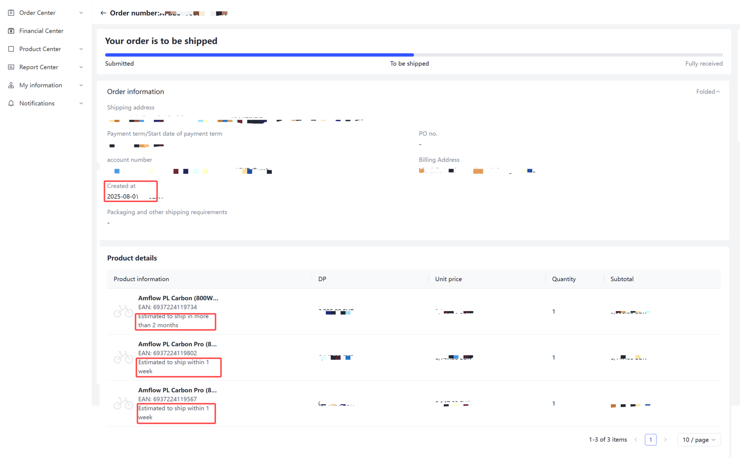
3.On the order details page:
After submitting the order, the estimated shipment time for purchased bikes will be displayed on the order details page.
Please note that the estimated shipment time is calculated based on the order created time.

